Slide 1

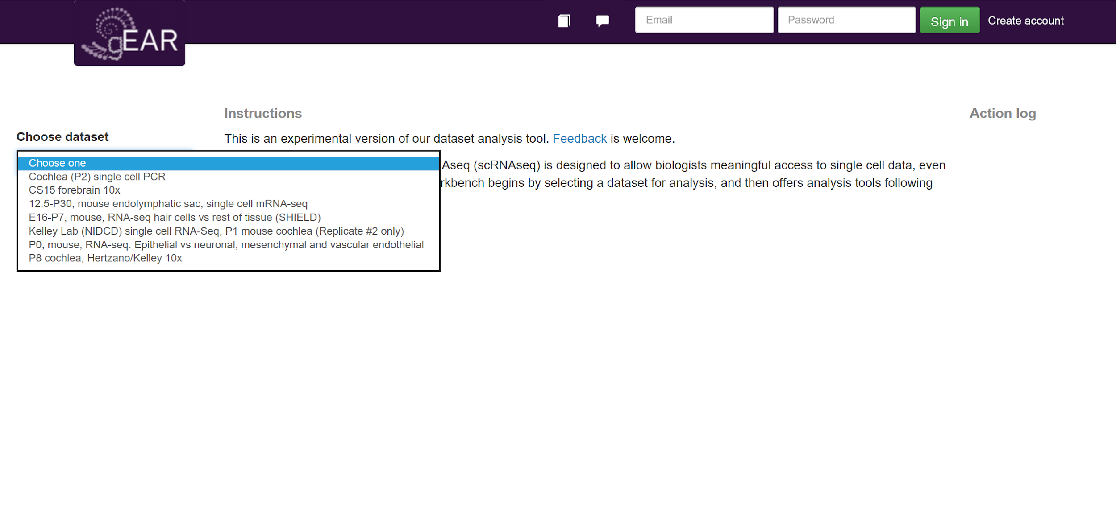
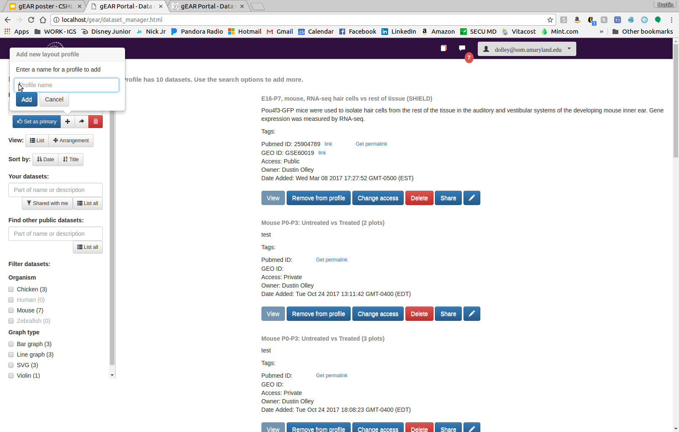
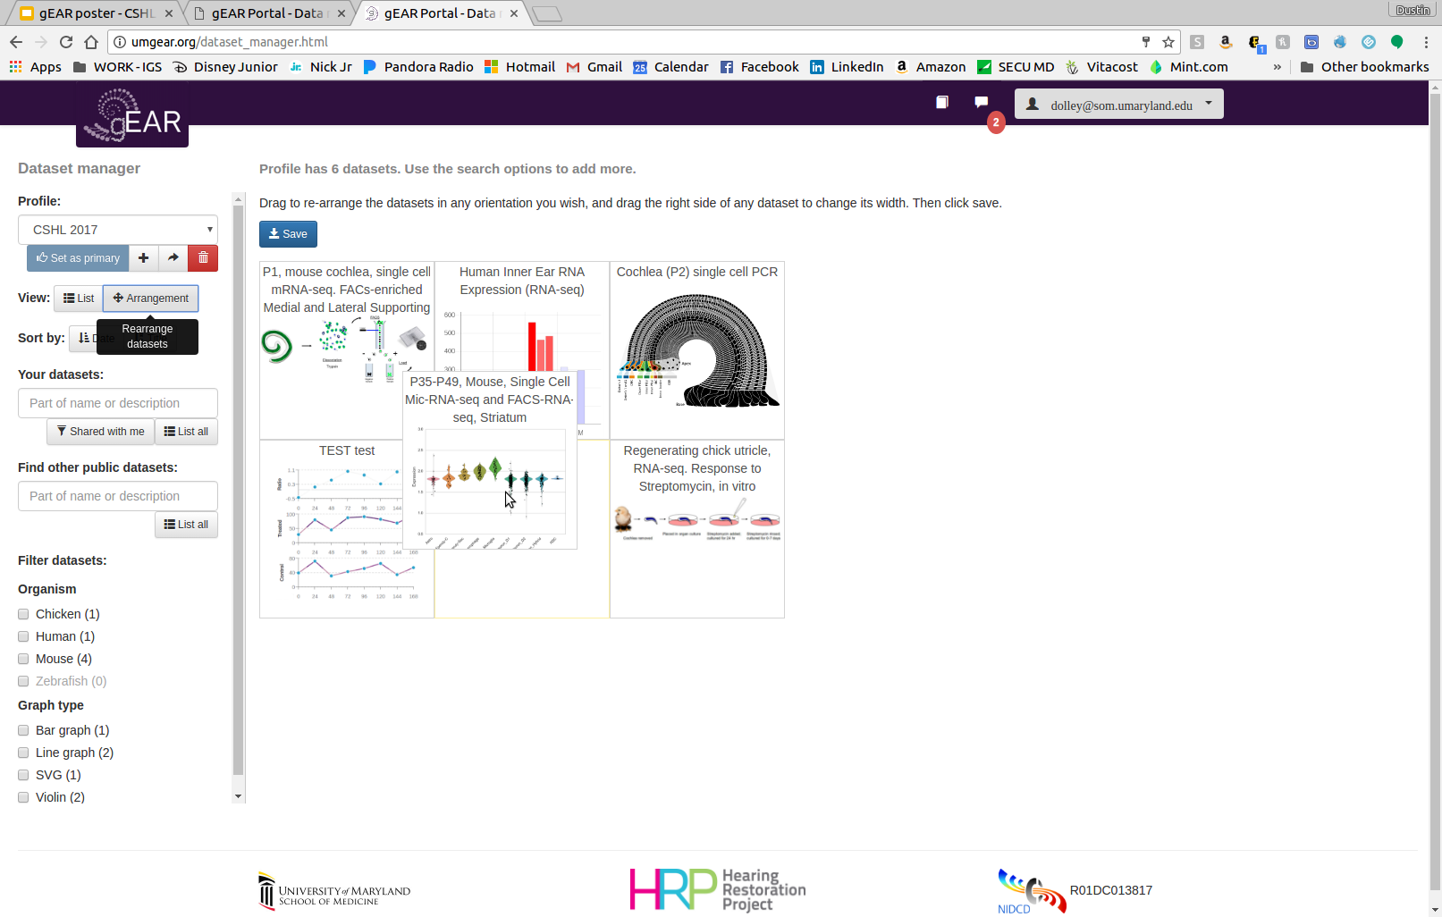



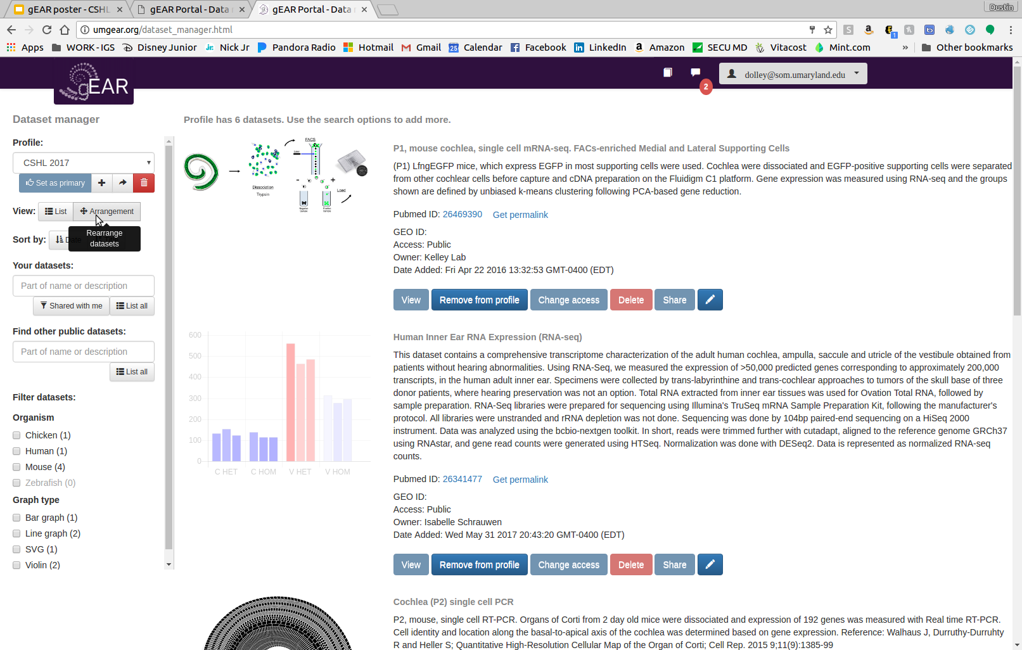
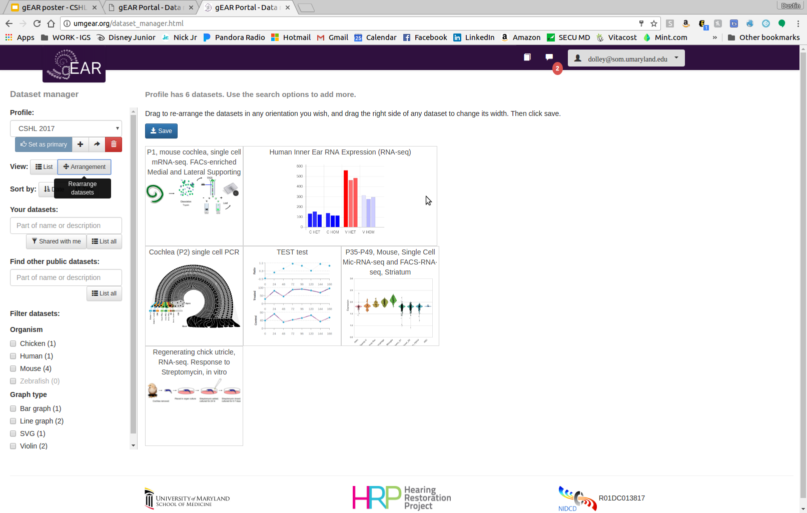
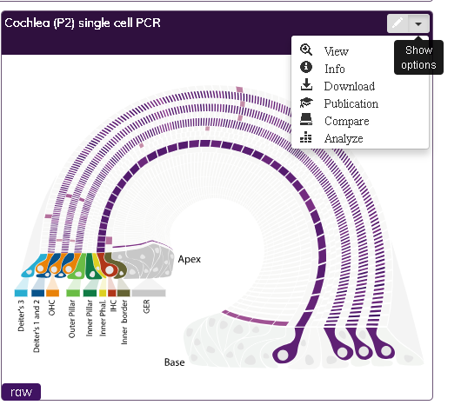
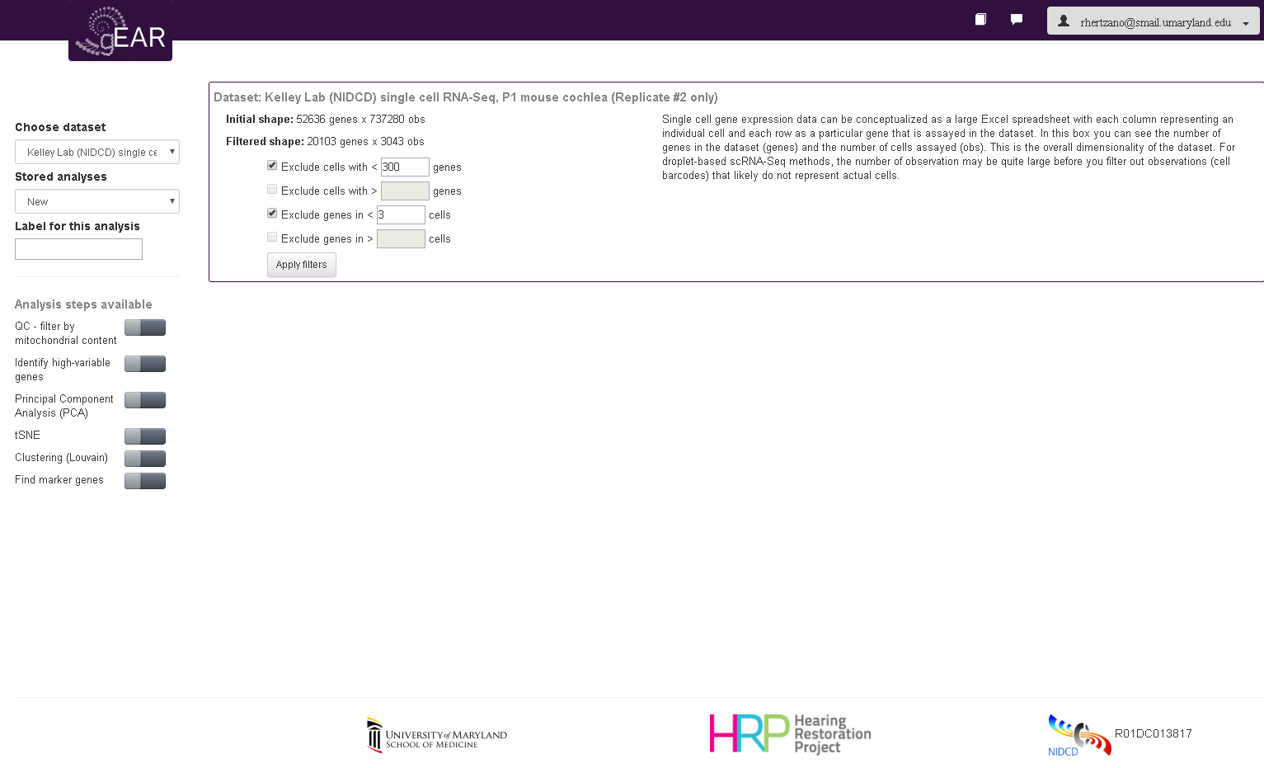
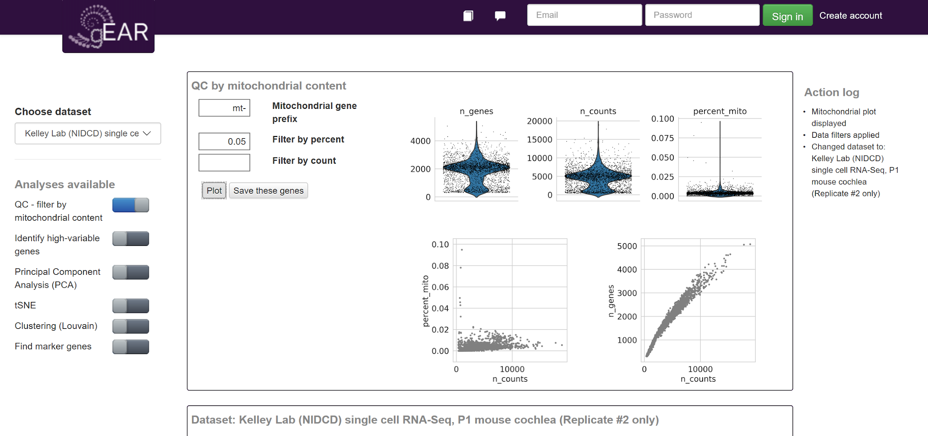
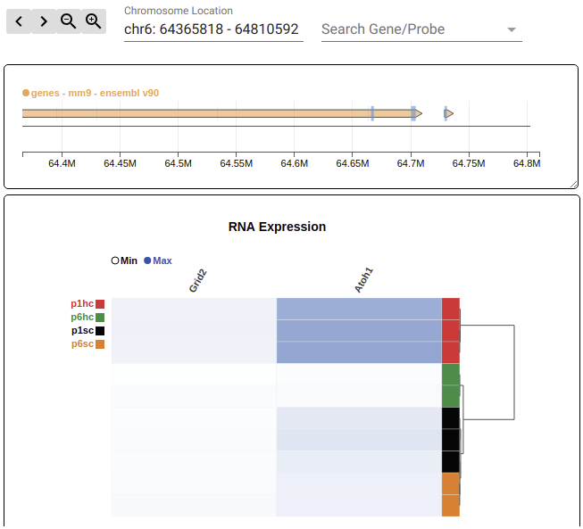
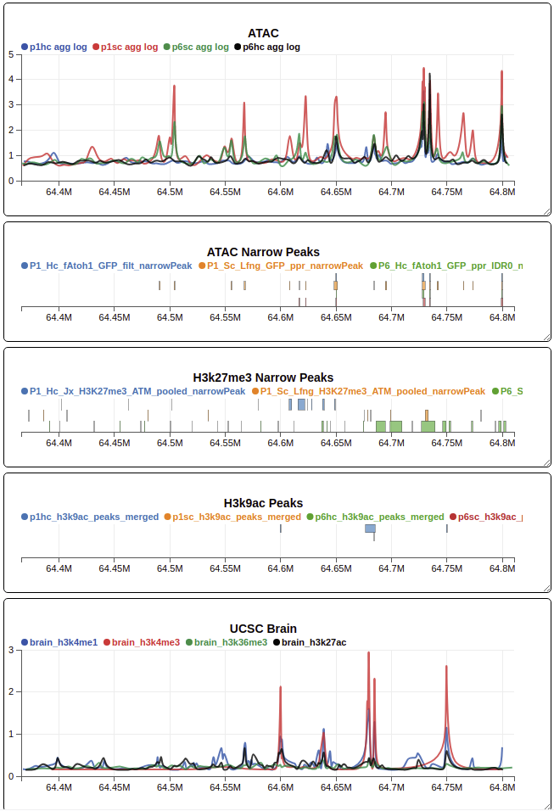
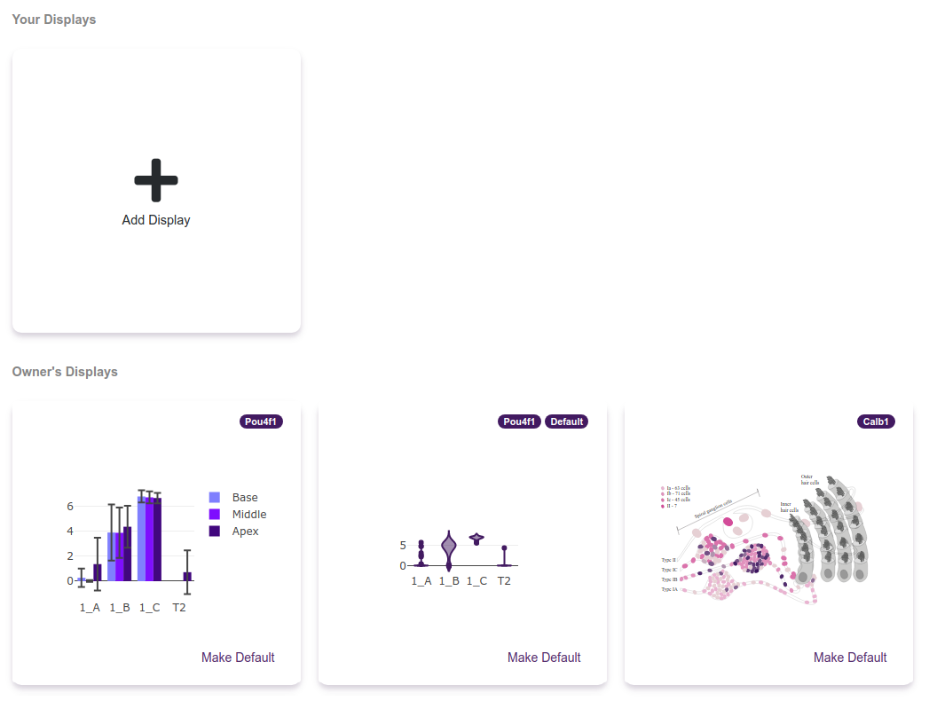
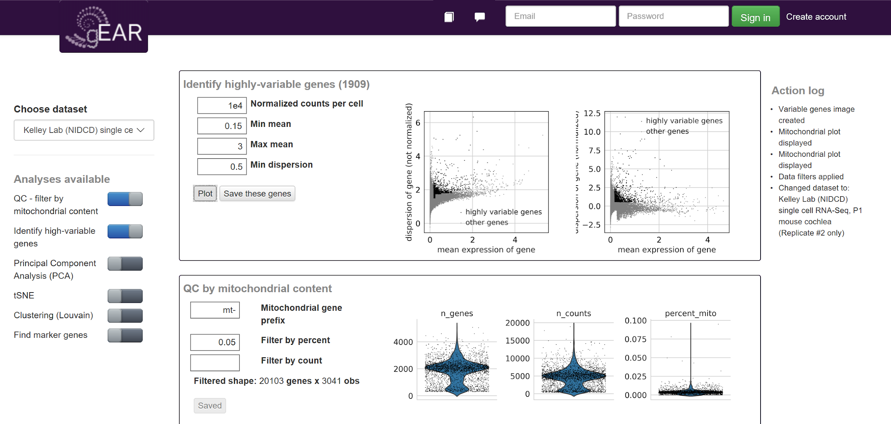
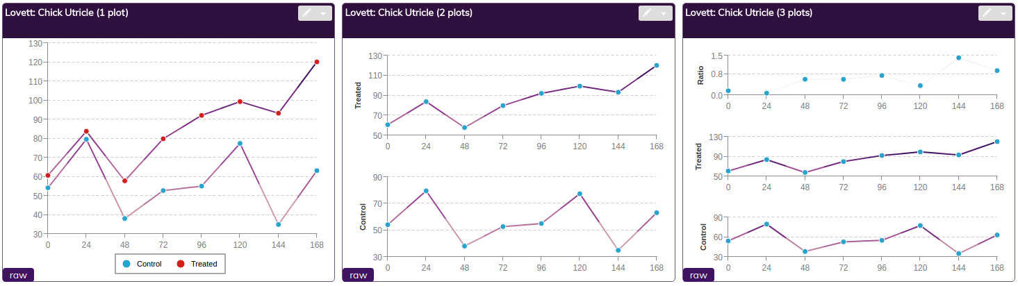
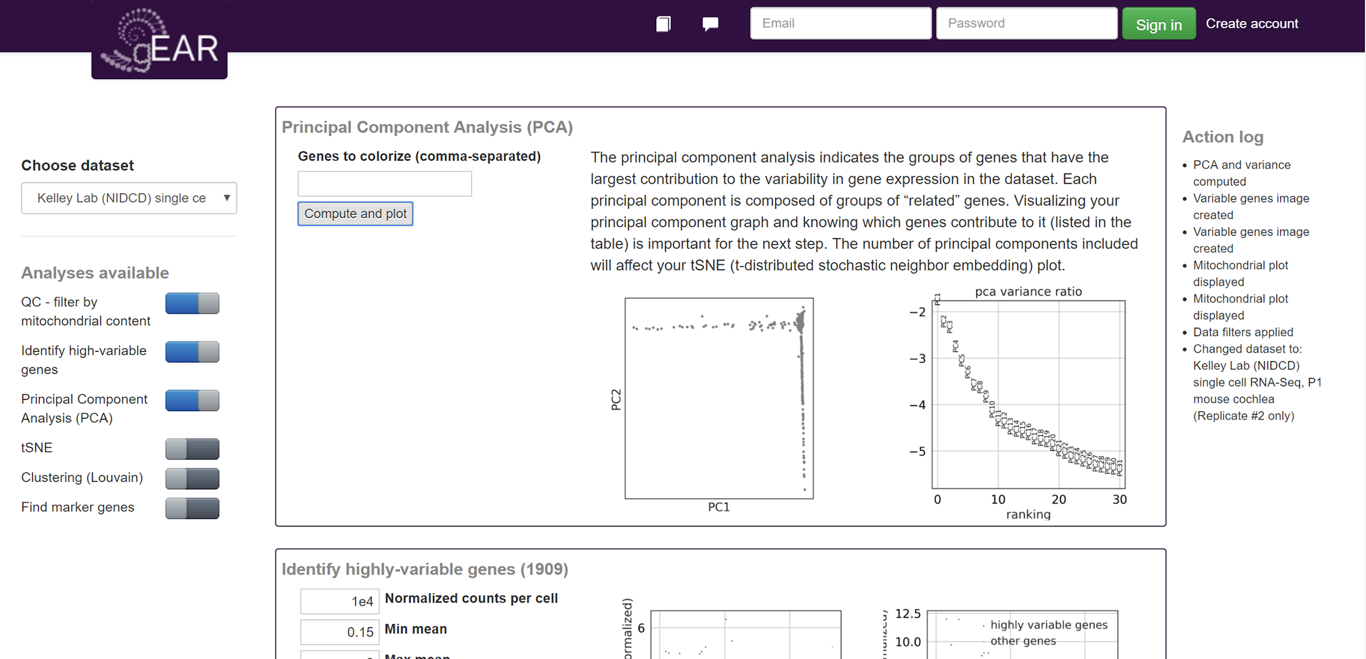
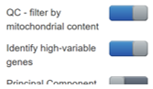
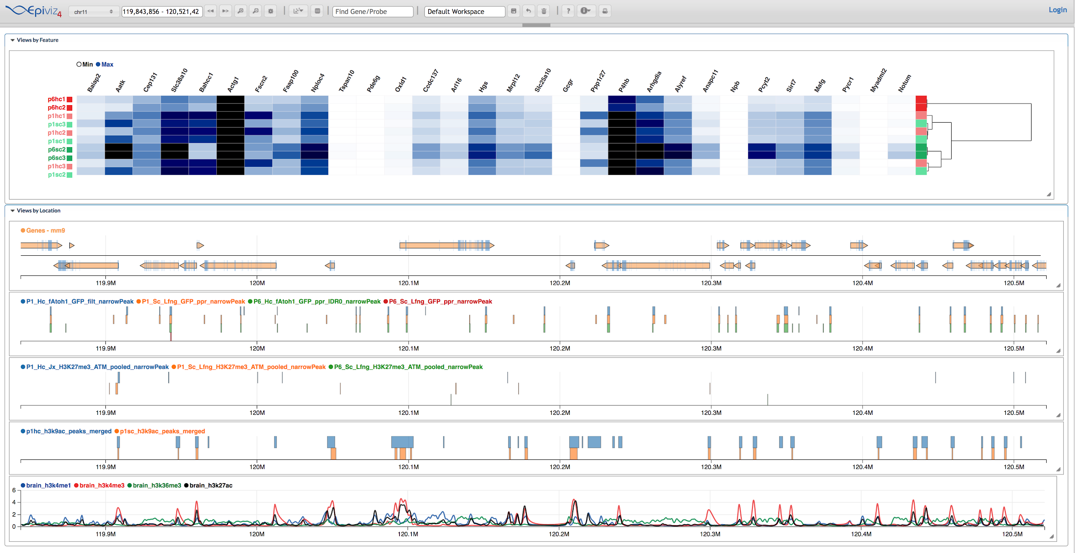
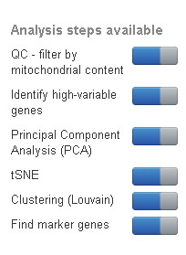
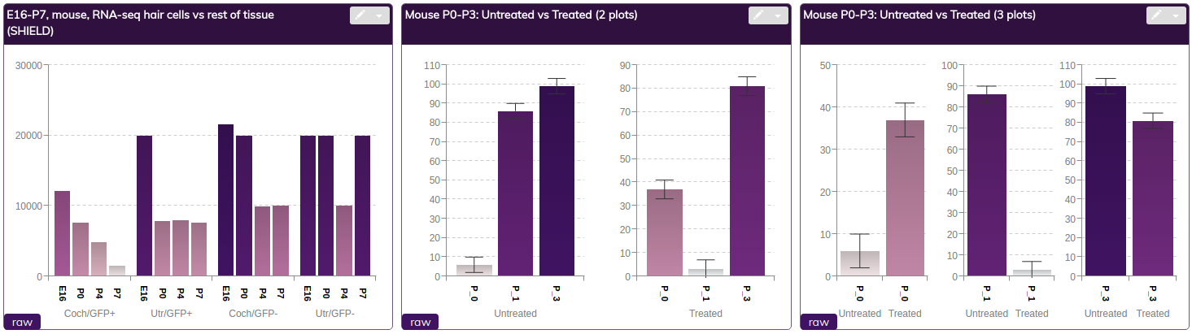
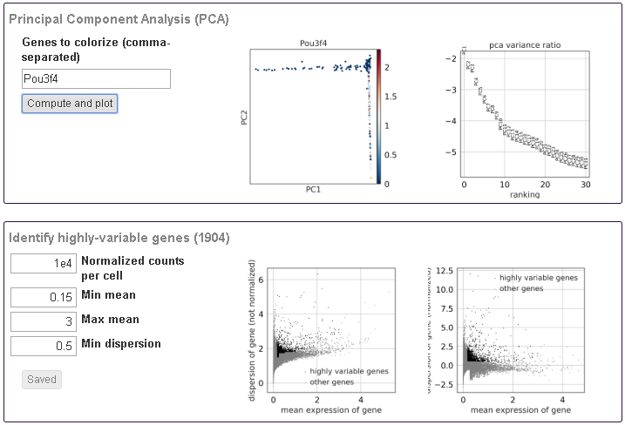
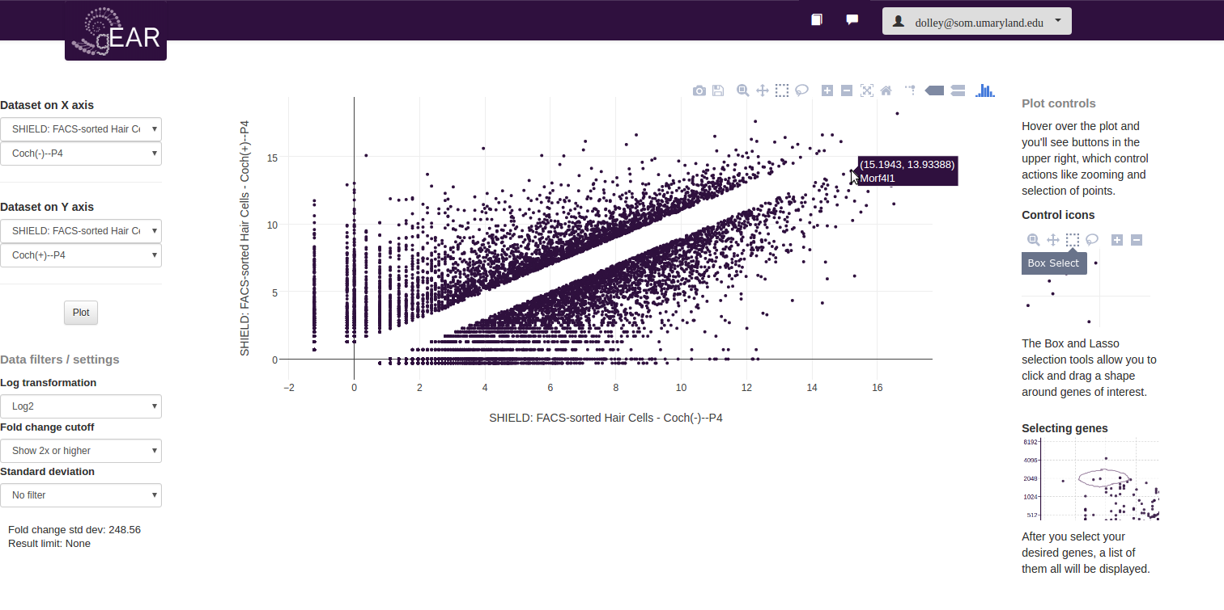
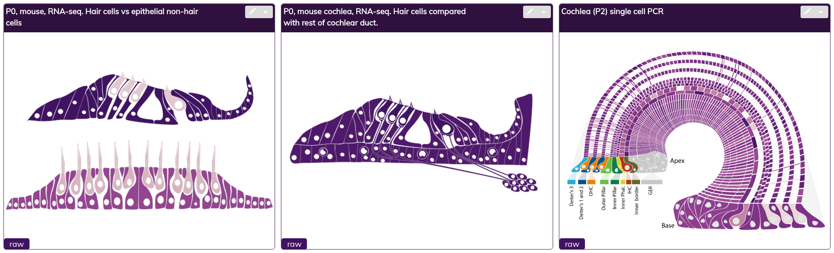
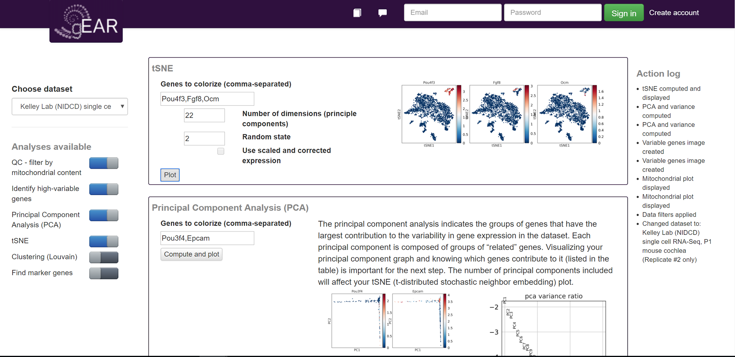
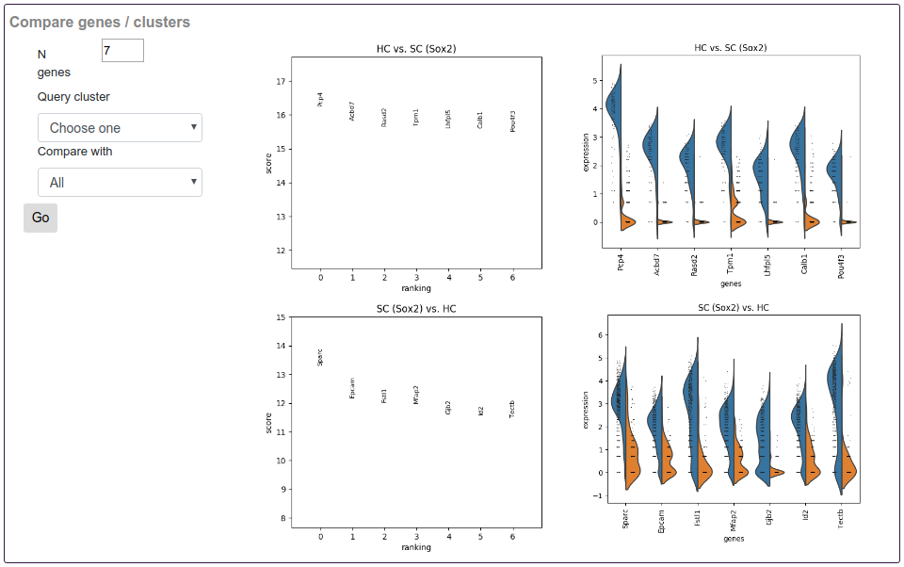
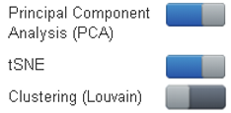
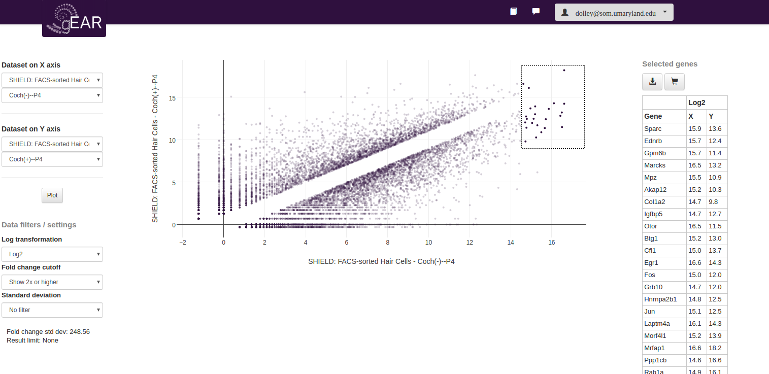
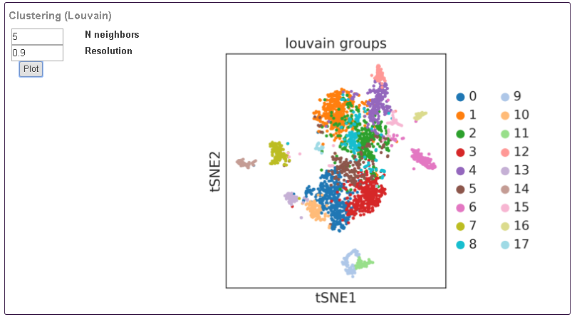
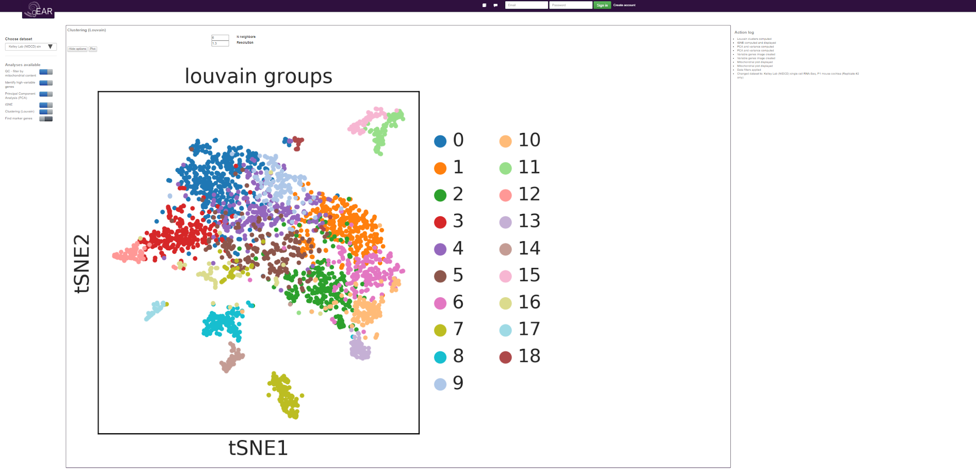
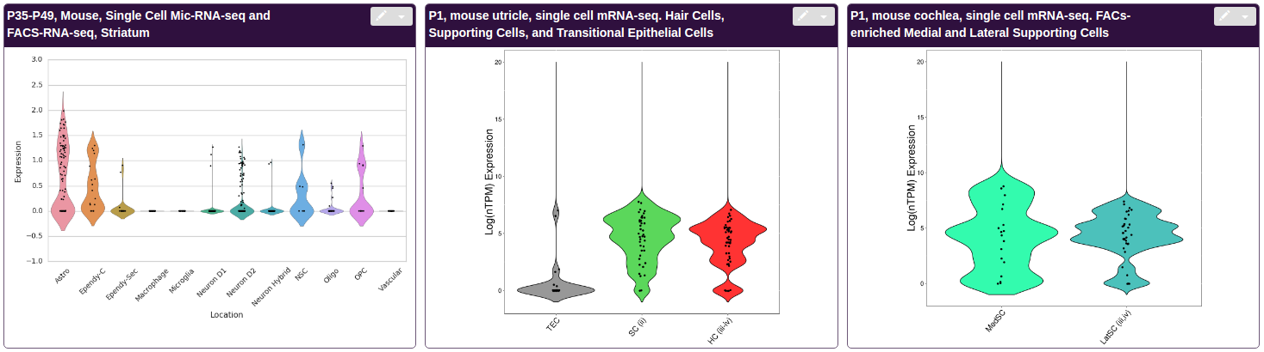

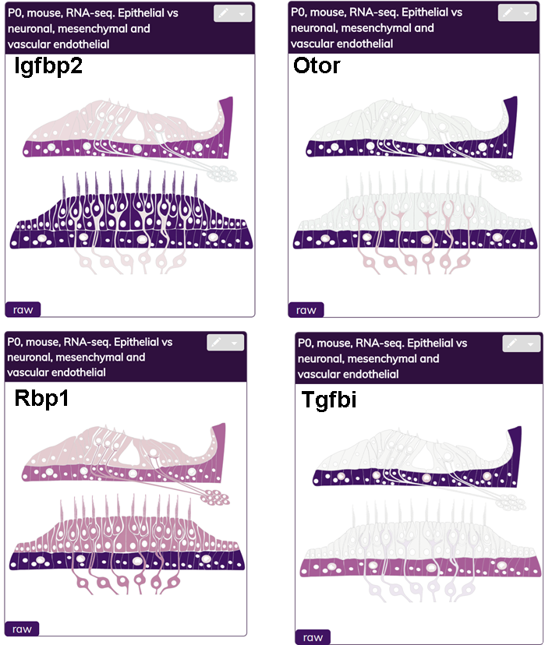
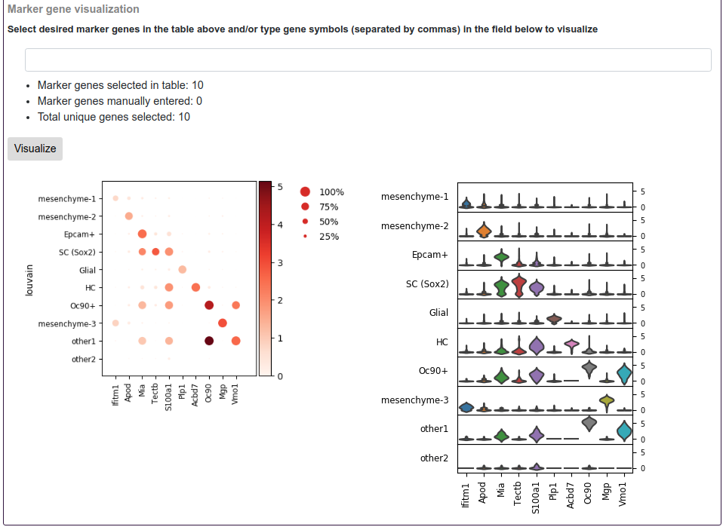
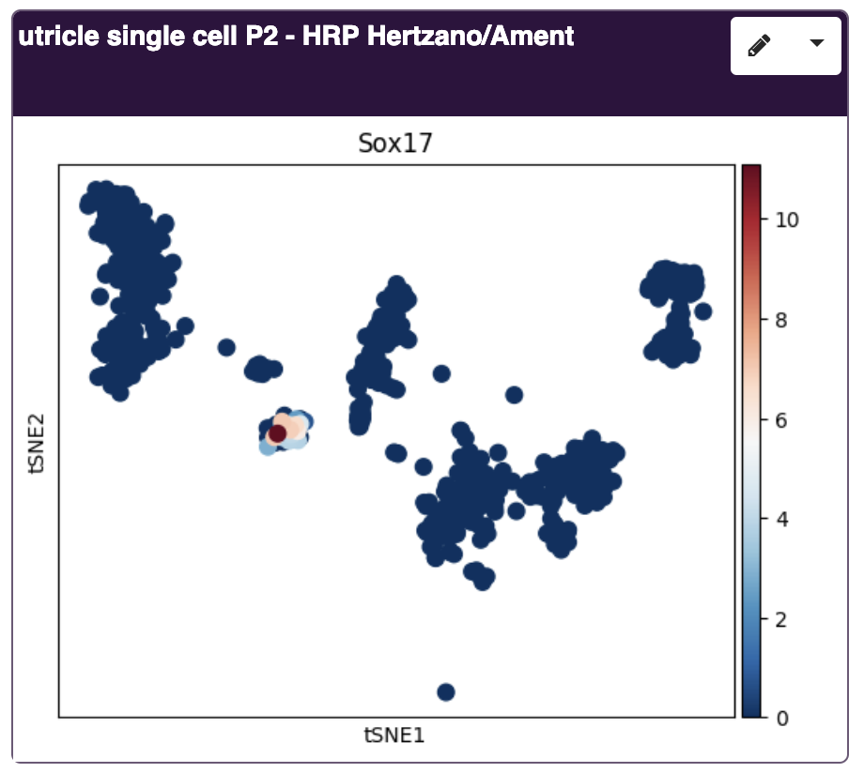
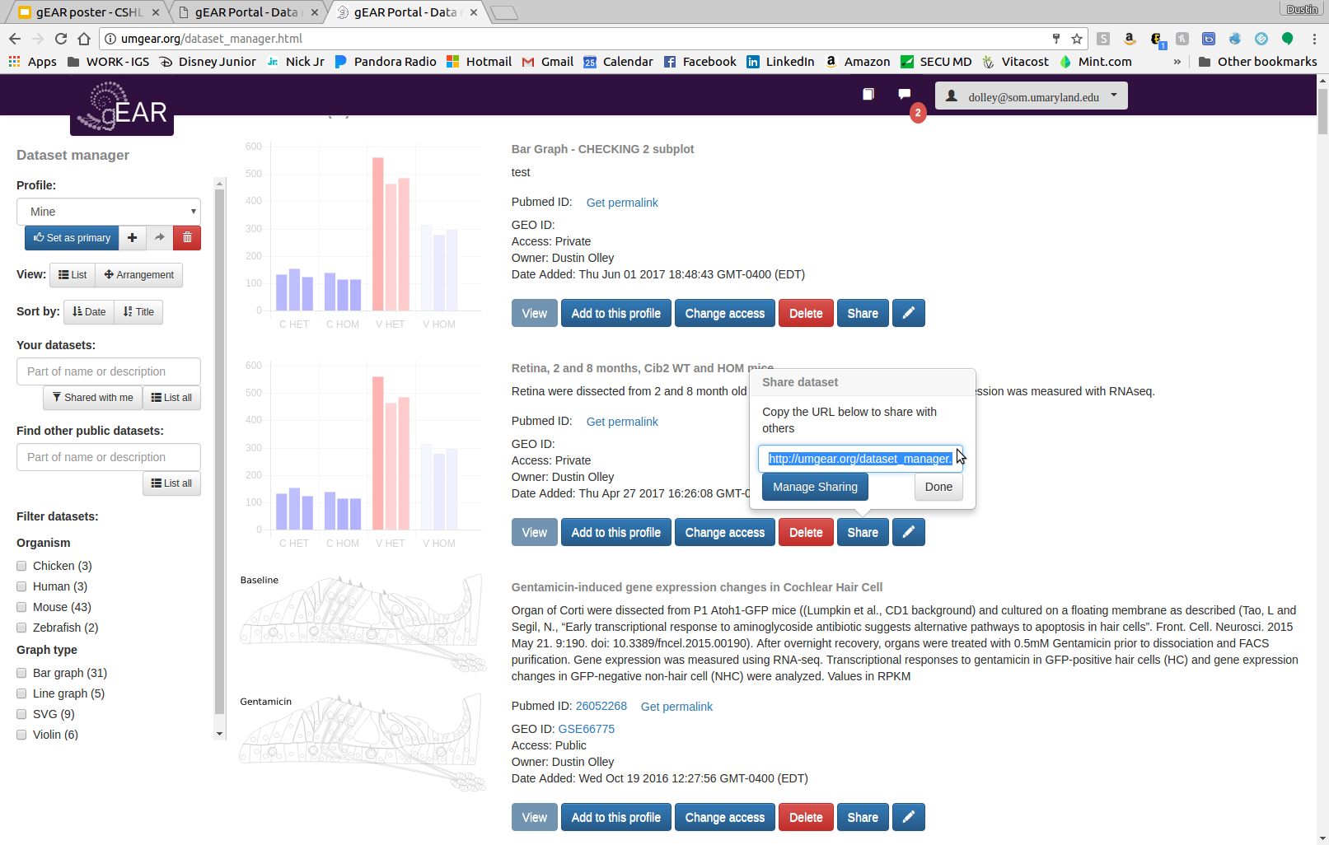
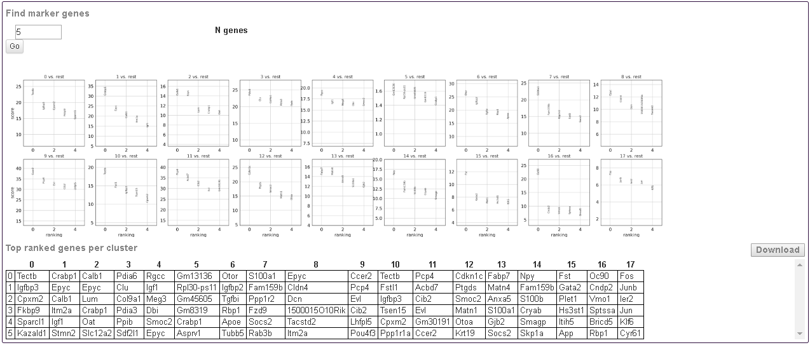
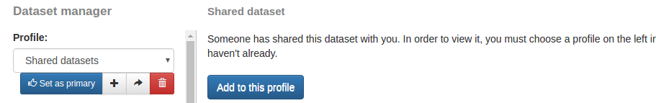
New year, new gEAR: Better performance, new features, and more data
Joshua D Orvis¹, Brian Gottfried¹, Dustin J Olley¹, Jayaram Kancherla⁶, Beatrice Milton⁴, Yang Song¹, Hector Corrada-Bravo⁶, Amiel Dror², Michael Kelly³, Anup A. Mahurkar¹, Ronna Hertzano^{1,3,4} Affiliations: ¹Institute for Genome Sciences, University of Maryland School of Medicine; ²Department of Otolaryngology, Galilee Medical Center, Nahariya, Israel; ³National Institutes of Health, NIDCD, Bethesda, MD; ⁴Departments of Otorhinolaryngology Head & Neck Surgery and ⁵Anatomy and Neurobiolology, University of Maryland School of Medicine; ⁶University of Maryland Institute for Advanced Computer Studies
The gEAR portal (gene Expression Analysis Resource) is an online tool for multi-omic and multi-species data visualization, sharing, and analysis. Originally designed for auditory and vestibular researches, the gEAR portal has now been expanded for general use. The gEAR is unique in its ability to allow users to upload, view and analyze their own data in the context of previously published datasets, as well as confidentially share their data with collaborators prior to publication. It is also unique in combining not only multiple species but multiple data types including bulk RNA-seq, sorted cell RNA-seq, single cell RNA-seq (scRNA-seq) and epigenomics in a one page, user-friendly, browseable format. Individual expression datasets can be displayed in a variety of ways alongside each other, including interactive bar, line or violin plots, and colorized anatomical SVGs.
Most recently, scRNA-seq has matured as a commonly used technique for measuring gene expression across tissues. To provide researchers access to scRNA-seq data regardless of their programming knowledge, we have integrated a scRNA-seq workbench into the gEAR. The gEAR scRNA-seq workbench provides access to both the raw data of scRNA-seq datasets, as well as to saved expert analyses where cell types have already been assigned – giving researchers rapid insight into gene expression of their cell type of interest.
Recent integration with EpiViz allows evidence tracks based on genomic coordinates like epinetic data (methylation sites, ChIP-seq, ATAC-seq, etc.)
The gEAR portal is publically available and can be accessed through umgear.org
Customized Dataset Layouts
The Single Cell Analysis Workbench
Your Data in Context of Others
Custom layouts let you decide what datasets to search, and arrange your layout profile how you want it. The order and width of the datasets can be changed in a custom layout.
The Single Cell Analysis Workbench is a tool under active development. This tool currently implements much of the Seurat pipeline in a graphical user-interface and in an implementation that allows faster data processing and visualization than standard R-based pipelines.
Compare and query your data along beside other data. No other resource allows you to dynamically compare your data across datasets and organisms on-the-fly.
1 - Add New Layout
3 - Rearrange Datasets
1.
Create a new custom layout profile.
Click and drag datasets to rearrange them.
1 - Choose a dataset
2 - Click Arrangement
4 - Resize Datasets
The analysis workbench is accessible from the dropdown menu
The gEAR is funded by the Hearing Health Foundation (Hearing Restoration Project) and the NIDCD/NIH R01DC013817 (RH).
Visit us at
UMgEAR.org
Rearrange and resize datasets here.
Drag the right side of datasets to resize them.
2 – Filter by gene number
After choosing the dataset (1) and obtaining the ‘dataset structure’ (2) work through the steps of the analysis using the ‘toggle buttons’
A quality control step follows (3). This filters cells based on their mitochondrial content.
To perform the downstream principal component and tSNE analysis first identify a group of highly variable genes (4). For efficiency, the workbench limits users to a maximum of 2,000 genes.
The PCA (5) outlines the number of principle components identified and allows users to examine the expression of genes in the first and second PCs. Coming soon – Heat Maps for the genes contributing to each PC.
Generate a tSNE plot (6) by selecting the number of PCs to incorporate. You may check expression of genes of interest by typing their symbols in the search box.
Following the Louvain clustering (7) marker genes can be identified (8) and downloaded as a table to then use as input to search other datasets for validation. For example – population ‘6’ (top gene Otor) is clearly mesenchymal cells.
3 – QC mito
Customizable dataset views
Integration with EpiViz 2
3.
Multiple views of a single dataset can now be created using the Dataset Curator by dataset owners and users, allowing full customization of what and how data are shown. You can also toggle between available views on the front page on the fly.
EpiViz is a linear genomic browser. Integration with EpiViz 2 allows users to see the epigenetic status around selected genes of interest.
For example, on the right is the genomic locus of Grid2 and Atoh1 with its ATAC-seq, H3k27me3 and H3k9ac in different cell types of interest.
Below is a zoomed out view of a larger locus that includes both epigenetic data and expression data in the heat map above the linear view.
Data Visualization Types
The curator allows you to create as many of these views as you like, including drag/drop property ordering, X/Y axis selection, color gradients, and more.
Currently data can be visualized in line and bar graphs, scalable vector graphics (SVG), and violin plots. Each visualization type is rendered on-the-fly to produce near instantaneous results.
4 – Variable Genes
Line and bar graphs can be split into 2 or 3 subplots. Each can include standard deviation bars. Titles can also be added for each subplot.
4.
5 – PCA
Pou3f4
Dataset Comparison Tool
5.
Compare conditions within a dataset or between datasets.
Data columns from the expression file are assigned to <path> elements to link expression values to regions of the SVG.
1 - Select X and Y axis
6 – tSNE / UMAP
10 - Compare genes / clusters
Select a dataset and condition for the X and Y axis, then plot.
Hover over a plot point to see the gene symbol.
Finally, you can compare genes/clusters (10) by producing a bidirectional comparison of cluster pairs to visualize the genes which best differentiate between them.
6.
Violin or tSNE plots generally represent single-cell datasets.
2 - Draw to select
7 – Louvain
Draw around your area of interest to produce a list of these genes.
The gene list can then be downloaded or saved as a gene cart.
Collaborate Via Sharing
7.
The latest update includes the ability to display user-generated analysis components on the front page. After using the Single-Cell Workbench (see poster center) to generate an analysis, the output of some individual steps can be used on the front page to interrogate individual genes. The first of these are tSNE/UMAP plots with expression levels of the selected gene colorized.
Sharing datasets enhances collaboration. You can share your dataset by sending a dataset unique URL to your collaborators through email or chat. Shortened permalinks are ideal for use in manuscripts.
8 – Find Markers
Find marker genes
9 - Visualize markers
Send share URL
After you find marker genes (8) click cells in the marker gene table to select them for visualization (9), generating both stacked violin and dot plots to visualize expression in each cluster.
Once collaborators follow the share URL, the dataset can be added to a profile and accessed.
Add to profile
8.

